Slide 1

Slidedeck Template
Danish Tech Challenge Application 2026

Slide 2
Part 1
Introduction

Slide 3
How to use this document?
This document is designed to guide you through the process of creating a slide deck for your Danish Tech Challenge 2026 application.
This document includes both a slide deck template (Part 2) and an example deck (Part 3). You're welcome to use the provided template or your own pitch deck — just make sure your slides cover the key elements outlined in the template and are structured in the same order.
We expect your slide deck to include the following sections:
Cover Page
Problem
Solution & Market
Technology & Competitive Edge
Product Development & Prototype
Customer Outreach
Funding and Financial Situation
Team
Milestone Plan

Slide 4
Part 2
Slidedeck Template - Danish Tech Challenge Application

Slide 5
Insert Company Name
Insert two-liner describing of your startup

Slide 6
Problem
Describe the problem you are solving.
Use graphics, photos and text as you like.

Slide 7
Solution & Market
Describe your solution. How and why does it work? Make sure the solution is clearly linked to the problem described on the previous slide.
Describe the market and customers you are targeting.
Use graphics, photos and text as you like.

Slide 8
Technology & Competitive Edge
Describe the technology that enables your solution and/or your competitive edge compared to competitors. What is new about your solution?
Outline your IP strategy and current status. Have you already secured a patent, are you in the process of applying, or do you not intend to pursue patent protection?
Use graphics, photos and text as you like.

Slide 9
Product Development & Prototype
Insert a short description of the current status of your product development. To what extent have you tested the product/prototype?
Insert photo(s) of your prototype.

Slide 10
Customer Outreach
Customer Name | Interaction type | Date | Summary
 | Meeting/Test/etc. | MM/YYYY
List relevant interactions with potential customers, including a short summary of the outcome of the interaction.

Slide 11
Funding & Financial Situation
Funding Provider | Amount in DKK | Date | Equity in %
 |  | MM/YYYY
Provide a brief overview of your startup’s financial status. Include when you plan to raise your next round of funding and the funding provider you are targeting.

Slide 12
Team Founders & Key Team Members
Be aware.
Do only provide us with name and photo of team members, if no LinkedIn page is available.
Title
Education/Experience
Equity share
Full-time/half-time
Link to LinkedIn
Title
Education/Experience
Equity share
Full-time/half-time
Link to LinkedIn
Title
Education/Experience
Equity share
Full-time/half-time
Link to LinkedIn
Title
Education/Experience
Equity share
Full-time/half-time
Link to LinkedIn
Title
Education/Experience
Equity share
Full-time/half-time
Link to LinkedIn

Slide 13
Milestones Plan 6 to 12 months ahead
Milestone description
Milestone description
Milestone description
MM
YYYY
MM
YYYY
MM
YYYY
MM
YYYY
MM
YYYY
Milestone description
Milestone description

Slide 14
Part 3
Example Slides – Danish Tech Challenge Application

Slide 15

Sentar combats the negative effects of sedentary behavior by encouraging office workers to regularly change posture and position — ultimately reducing absenteeism and boosting performance.

Slide 16
Problem
Sedentary behavior is a major and growing societal issue, leading to back and neck pain as well as other lifestyle-related diseases. On average, 35% of the Danish population suffers from lower back pain — a number that rises to nearly 50% among office workers. For the average Danish company, sedentary behavior results in a loss of productivity worth DKK 30,000 per employee annually. The issue also places a significant burden on pension and insurance providers.

Slide 17

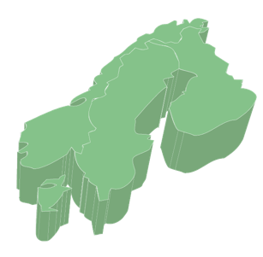
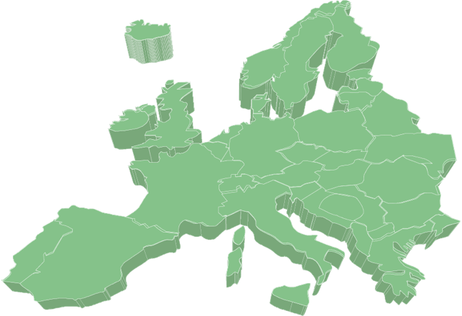
Solution & Market
Denmark
7 mio EUR/year
The Sentar bot encourages office workers to move more — the most effective way to prevent back and neck pain. While height-adjustable desks are common in offices, they’re often underused. The real challenge is changing user behavior. The Sentar bot is placed on the user’s desk, where it detects presence, monitors desk height and flow of work. Based on this data, it evaluates when the user needs to switch between sitting and standing positions. The Sentar bot takes into consideration whether the office worker are in a productive flow, making sure not to interrupt with a prompt at a disruptive time. The prompts are based on nudging and gamification principles, to make sure the office workers are motivated.
Our target customers are medium to large enterprises with predominantly white-collar workforces, located in markets with a strong focus on workplace ergonomics. First market entry is Denmark, with a quick expansion to Scandinavia. Within the next 5-7 years, a further expansion into Europe is planned.
Scandinavia
25 mio EUR/year
Europe
+280 mio EUR/year

Slide 18
Technology & Competitive Edge
The Sentar bot stands out from the competition in several key ways.
Unlike wearables and other devices designed to track user behavior, Sentar is uniquely capable of detecting the subtle height and posture changes that distinguish sitting from standing at a desk — a critical factor in delivering meaningful and timely feedback.
Existing solutions tend to act like basic timers, lacking the intelligence to account for workflow or user context. Sentar, by contrast, is designed to prompt movement in a smarter, more personalized way.
While we have not yet initiated the IP application process, we plan to file for a patent within the next 6–12 months.

Slide 19
Product Development & Prototype
We are currently in the process of developing the 3rd version of the prototype. Currently, in the 2nd version, the sensors are placed in a box underneath the desk, while the indicator is placed on top of the desk. In the 3rd version we aim to combine both sensors and the indicator in a unit standing on top of the desk. The 3rd version will be built around a color screen, making it possible to show both text, figures and animations.
The 1st and 2nd version of the prototype have been tested at Novo Nordisk and Coloplast.

Slide 20
Customer Outreach
Customer Name | Interaction type | Date | Summary
Novo Nordisk | Test w. 10 units | 01/2026 | Successful change of user behavior.
Coloplast | Test w. 20 units | 04/2026 | Successful change of user behavior.
Tryg Forsikring | Meeting | 05/2026 | Potentially interested in adopting the device and include it in their offerings.

Slide 21
Funding & Financial Situation
Funding Provider | Amount in DKK | Date | Equity in %
InnoBooster | 433.000 DKK | 11/2025
Alexander Foss Industrifond | 78.000 DKK | 01/2026
DTU Funding | 83.000 DKK | 03/2026
Jan Grarup (Business Angle) | 300.000 DKK | 05/2026 | 10%
Our current financial runway extends until February 2026, with a monthly burn rate of approximately DKK 65,000.
We plan to apply for the InnoFounder grant and have initiated early conversations with select business angels and venture capital firms.

Slide 22
Team Founders & Key Team Members
CEO
Business Development
CBS, Strategic Market Creation
30% ownership
Full-time
https://www.linkedin.com/in/lassekorsholmpoulsen/
CTO
Software Development
DTU, Design & Innovation
30% ownership
20 hours/week
https://www.linkedin.com/in/cbreinholt/
Lead Hardware Design
Hardware Development
DTU, Design & Innovation
30% ownership
Full-time
https://www.linkedin.com/in/mads-r%C3%B8mer-svendsen-4b49a342/

Slide 23
Milestones Plan 6 to 12 months ahead
500.000 DKK
Investment Round
InnoFounder Application
First sale
08
2026
10
2026
03
2027
04
2027
06
2027
Proof of Concept Test w. Tryg
Hire Full-Stack Developer

